Slide 1

Introduction to Amazon SageMaker
Amazon SageMaker is a fully managed machine learning platform designed to simplify the entire machine learning workflow, from data preparation to model deployment.
by Grace Ngari

Slide 2
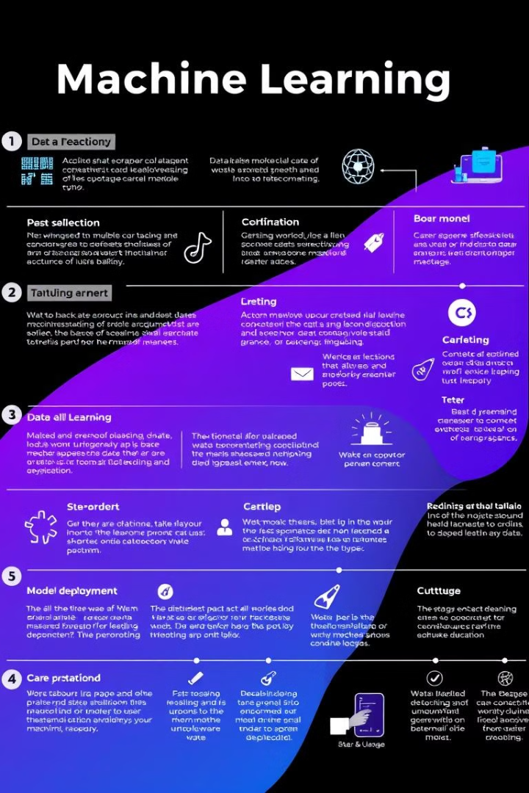
What is Amazon SageMaker?
Amazon SageMaker empowers data scientists and developers to build, train, and deploy machine learning models quickly and easily.
Data Preparation
Model Building
SageMaker offers tools for data ingestion, transformation, and feature engineering.
Build, train, and tune models using built-in algorithms or bring your own code.
Model Deployment
Model Monitoring
Deploy models for real-time predictions or batch inference at scale.
Monitor model performance and detect drift over time.

Slide 3

Key Features of Amazon SageMaker
SageMaker offers a comprehensive set of features to streamline the machine learning lifecycle.
1
Pre-built Algorithms
2
Custom Model Training
Leverage a wide selection of pre-trained models for various tasks.
Bring your own code and frameworks for flexible model training.
3
Automated Machine Learning (AutoML)
4
Scalable Infrastructure
Access powerful computing resources for large-scale model training and deployment.
AutoML simplifies model selection and hyperparameter tuning.

Slide 4
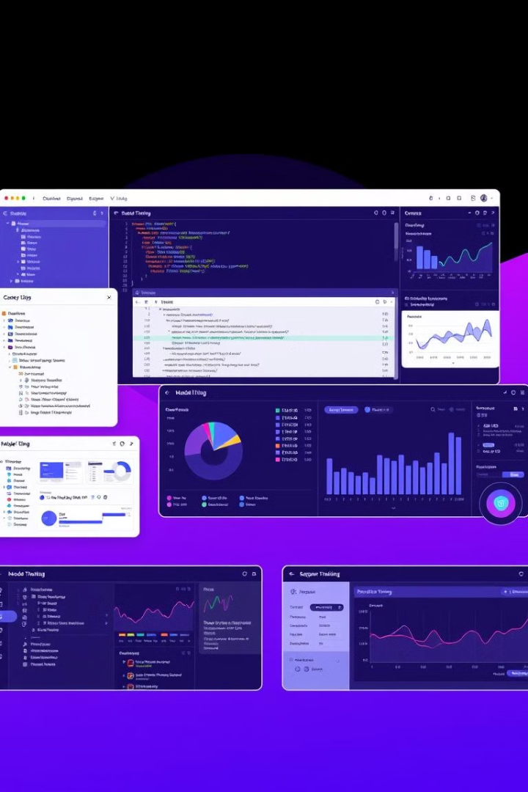
Building Machine Learning Models with Amazon SageMaker
SageMaker provides a user-friendly interface for building and training machine learning models.
1
Data Preparation
Load and prepare data for training using built-in tools.
2
Model Selection
Choose a suitable algorithm from the library or use your own code.
3
Model Training
Train the model with the prepared data and adjust hyperparameters.
4
Model Evaluation
Assess model performance on a holdout dataset and fine-tune if needed.

Slide 5
Deploying and Scaling Models with Amazon SageMaker
SageMaker simplifies model deployment and scaling to meet changing demands.
Real-Time Inference
Batch Inference
Scaling
Deploy models for low-latency predictions in real-time applications.
Process large datasets of data for offline predictions.
Automatically scale model resources to handle fluctuating workloads.

Slide 6




Monitoring and Debugging Models with Amazon SageMaker
SageMaker provides tools to monitor model performance and debug issues.
Model Drift Detection
Monitor model performance over time and identify changes.
Performance Metrics
Track key metrics such as accuracy, precision, and recall.
Debugging Tools
Troubleshoot model issues with logs, visualizations, and debugging tools.

Slide 7

Use Cases and Customer Success Stories
SageMaker is used by various companies across industries to solve a wide range of challenges.
Retail
Recommender Systems
Finance
Fraud Detection
Healthcare
Disease Prediction
Manufacturing
Predictive Maintenance

Slide 8

THE END

